Slide 1



ELAKSHME DEVI.C
LIBRARY MANAGEMENT
System

Slide 2


TABLE OF
Contents
01
Problem statement
02
Proposed solution
03
Objectives of LMS
04
Flow chart
05
Library Manager Source Code
06
Concepts for building LMS
07
Sample output of LMS

Slide 3

Problem Statement
Conventional libraries are having difficulty integrating various formats, including multimedia and e-resources, because of outdated management systems. Inefficient cataloguing, resource tracking bottlenecks, and a lack of analytics tools hinder librarians from optimizing collections and improving user experiences. To close the gap, libraries require a modern library management system with an intuitive interface, effective cataloguing, and analytics capabilities to resurrect libraries as vibrant centres of knowledge and community involvement in the digital era.
LMS
Page 01 of 07

Slide 4

Proposed Solution
To solve the traditional issue we are building a Web development project of library management system using C and data structures in which we will be providing User-friendly interface for easy navigation, Efficient book search functionality , seamless book issuance and return policy , automated tracking of library activities, Regular maintenance of book availability records and Secure login and access control managed by the admin.
SKILLS
LMS
Page 02 of 07

Slide 5


The objective of the Library Management System (LMS) project is to design and implement an efficient and user-friendly system that automates the various tasks associated with managing a library.
Objective of Library Management System
Efficient Book Management
User Friendly Interface
Automation of processes
Enhanced search and retrieval
Security and access control
Scalability
LMS
Page 03 of 07

Slide 6
FLOW CHART OF LIBRARY MANAGEMENT SYSTEM
LMS
Page 04 of 07

Slide 7

Library Manager Source Code
Add book
Display all books
Search by author
Search by title
Delete a book
Sort by title
Sort by author
Sort by price
Exit
LMS
Page 05 of 07

Slide 8

Concepts for building LMS
There are many components or key elements used to construct the library managemnt system such as follows
Switch statement
Arrays
Looping constructs
String function
Function prototypes
Structure definition
LMS
Page 07 of 07

Slide 9
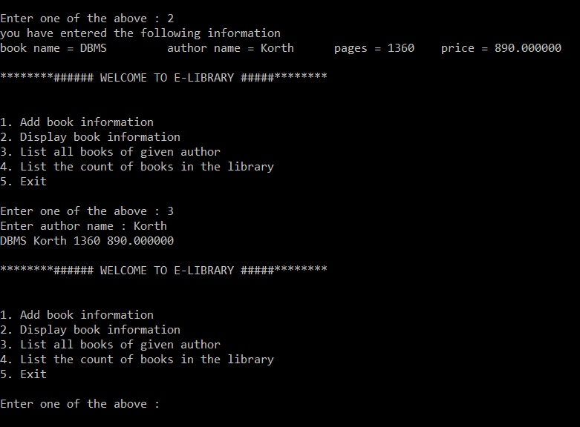

SAMPLE OUTPUT
LMS
Page 06 of 07

Slide 10

THANK
You

